Slide 1
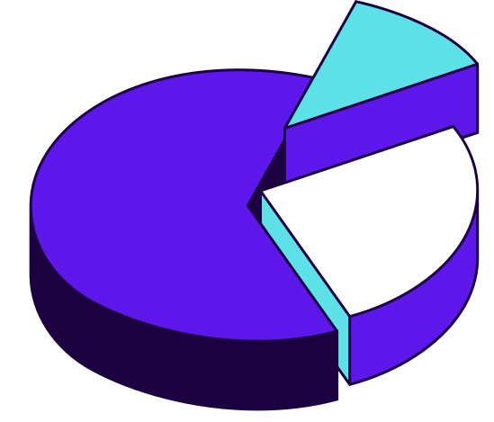
NULL Value
Matrix Report
ON HCES 2023-24
Author: Rudra Prasad Bhuyan
Position: Data Scientist Intern
Organisation: SBC Labs
Guidance: Anushka Ashok, Alok Gangaramany

Slide 2
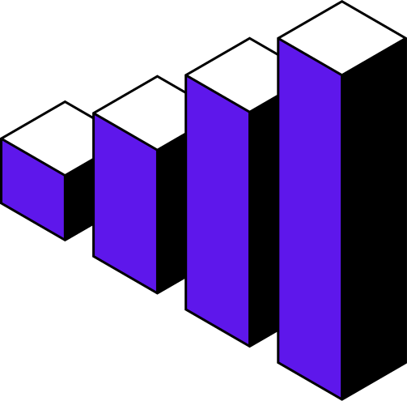
Table of Contents
Null Value Analysis
  Survey/Household
  Person
  Socio-Economic
  Ration/Online
  Food Consumption
  Consumption Value
  Benefits/Welfare
  Non-Food Items
  Non-Durabels
  Services/Utillities
  Assets/Possessions
  Clothing/Footwear
  Durable Goods
  Total Expenditure
  Summary/ Metadata
Filling Method Suggestions

Slide 3
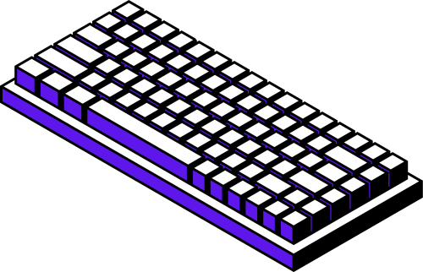
Introduction
  After encountering a large number of null values in the dataset, we decided that since this dataset is very important, we cannot compromise on data quality. Because most of the features (or columns) are checkbox-type, we can fill the missing values with null to maintain consistency.
  We can then perform feature engineering on the remaining features to achieve the desired output.
  In this report, I will present the missing values, the level names, and the suggested methods for filling in the missing data.

Slide 4

NULL Value Analysis
  I used Polars, and after filtering the data for the MP state (labeled as 23), I cast the selected features to Int16 to save storage space.
  I also filtered out the useful features to reduce computation time when generating the correlation plot, and calculated the percentage of null values using the Polars Python library.
  After completing the state and feature selection, as well as the data type conversion, I converted the dataset into a Pandas DataFrame. Then, I used the Missingno Python library to visualize the missing values.

Slide 5
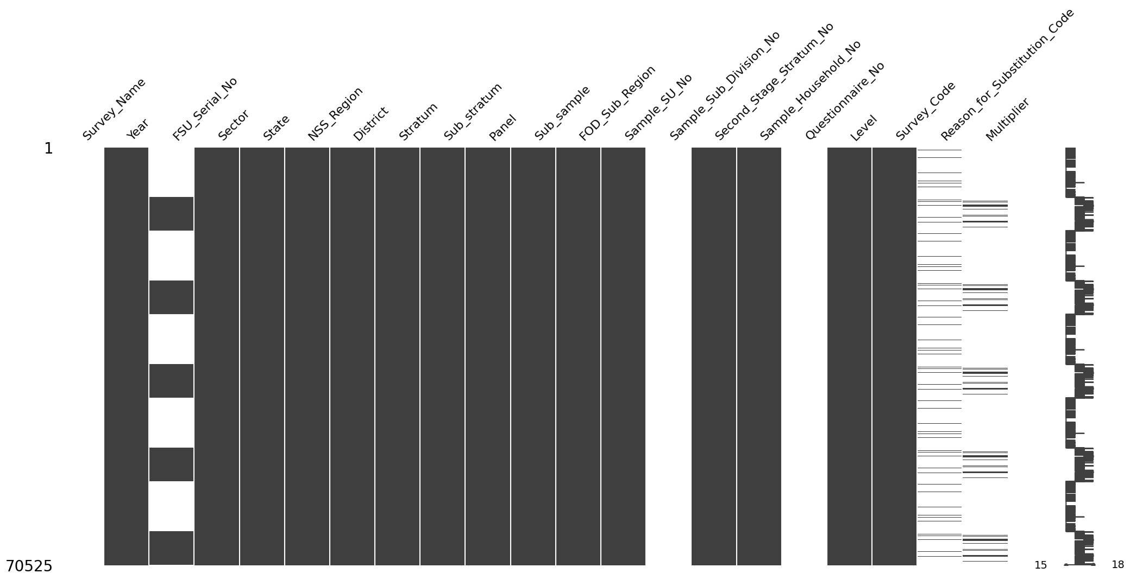
level 01: sURVERY/hOUSEHOLD

Slide 6
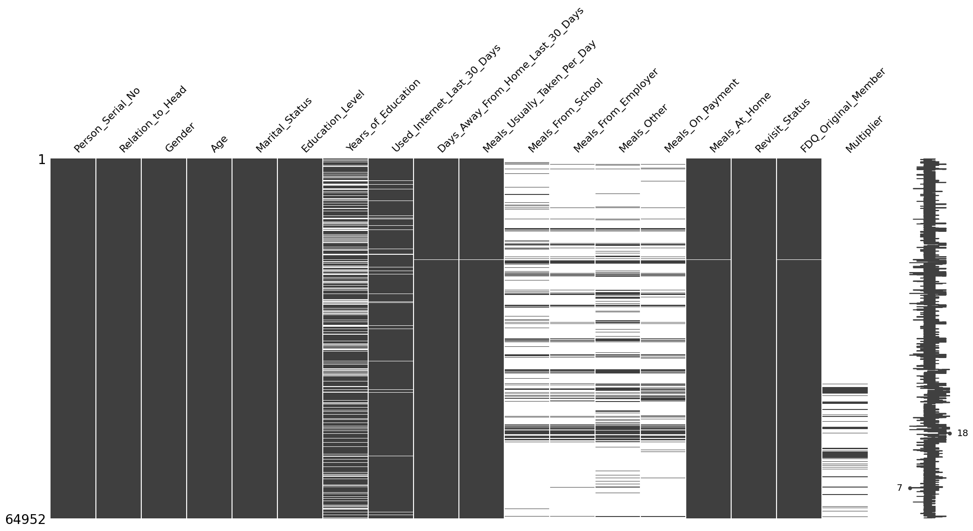
level 02: PERSON

Slide 7
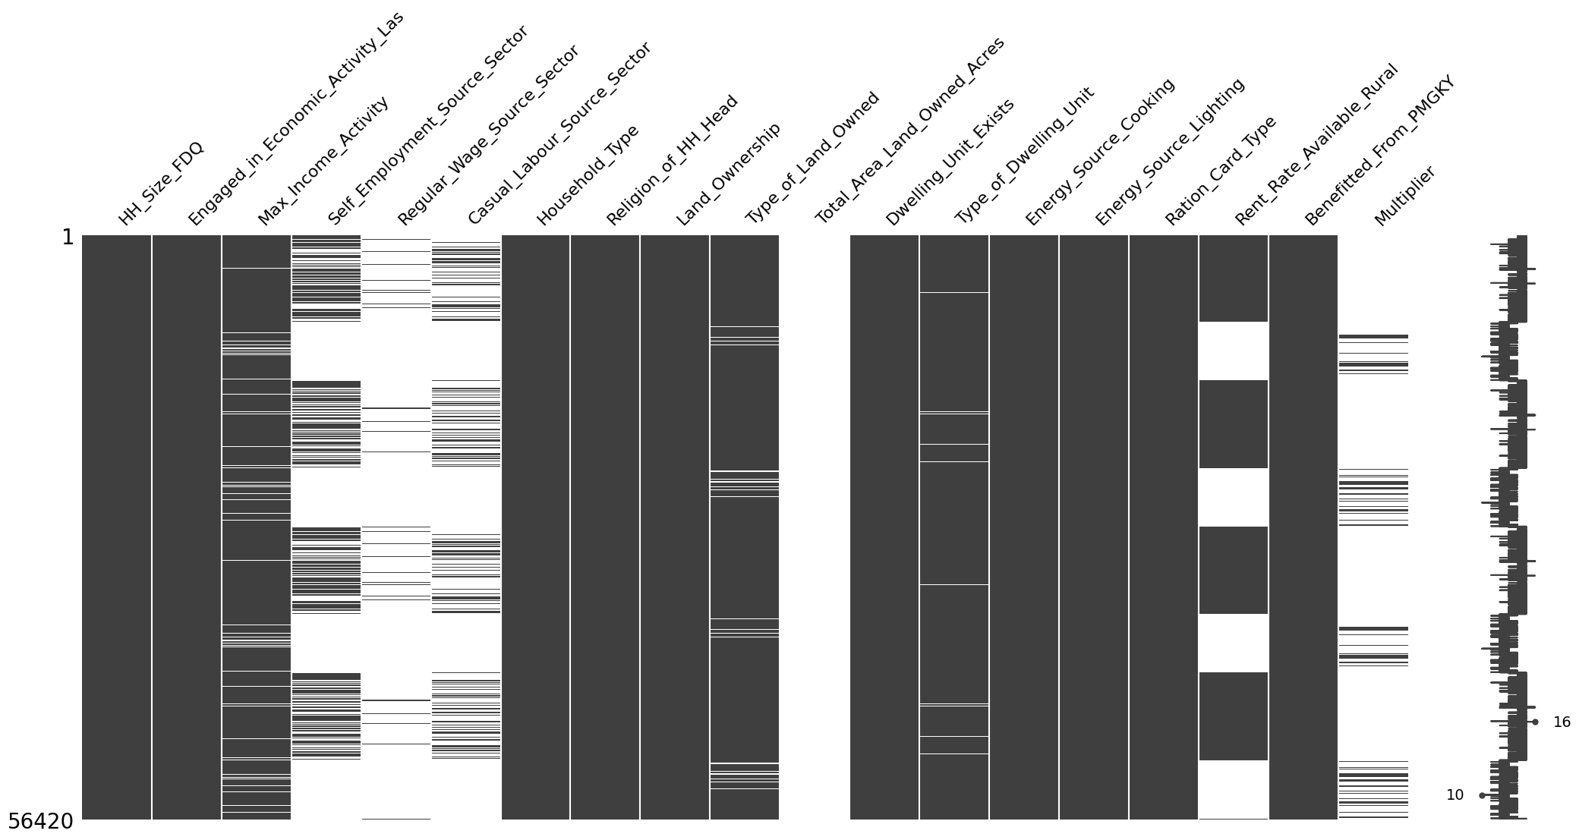
level 03: SOCI0-ECONOMIC

Slide 8
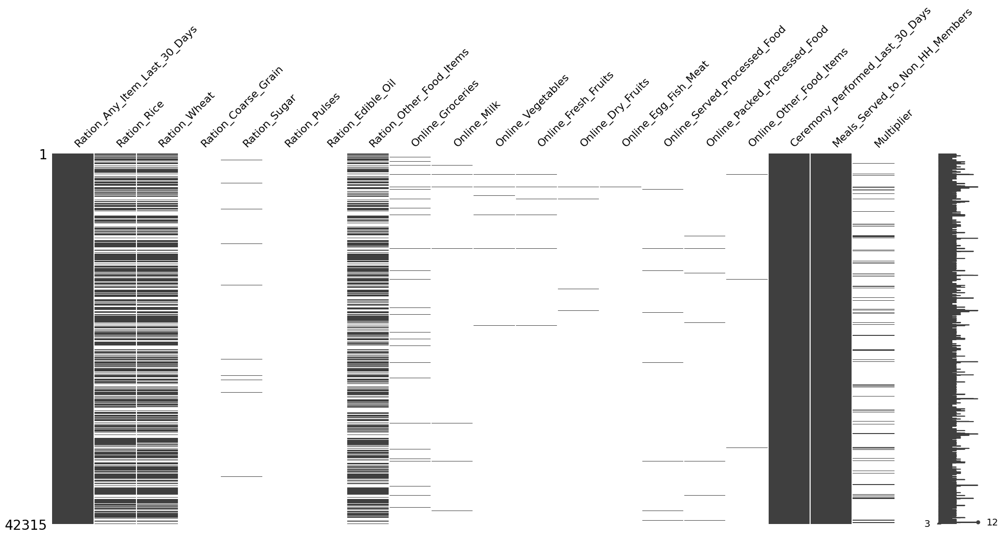
level 04: RATION/ ONLINE

Slide 9
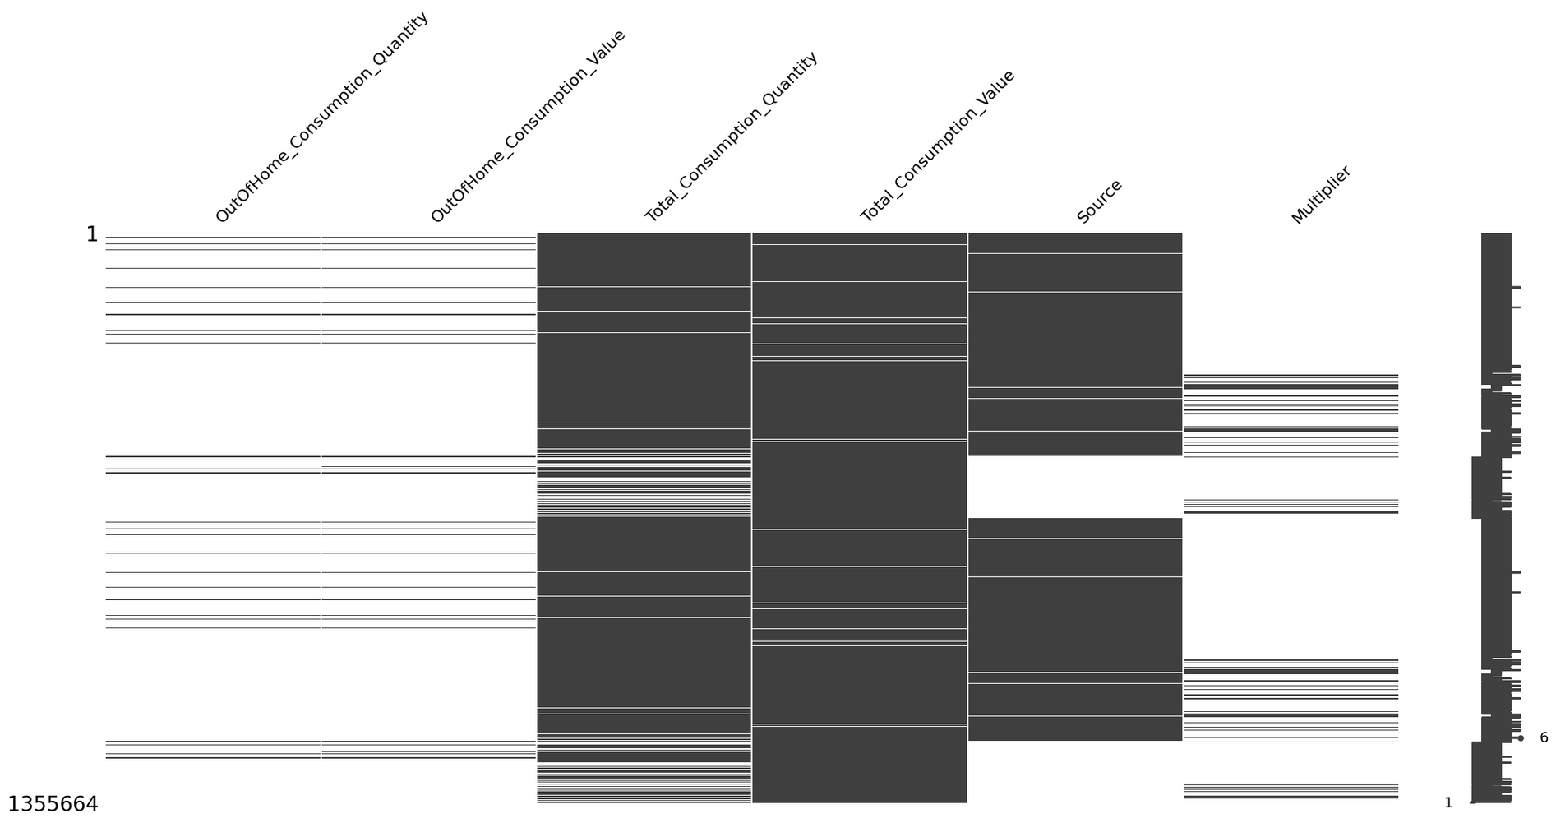
level 05: FOOD CONSUMPITION

Slide 10
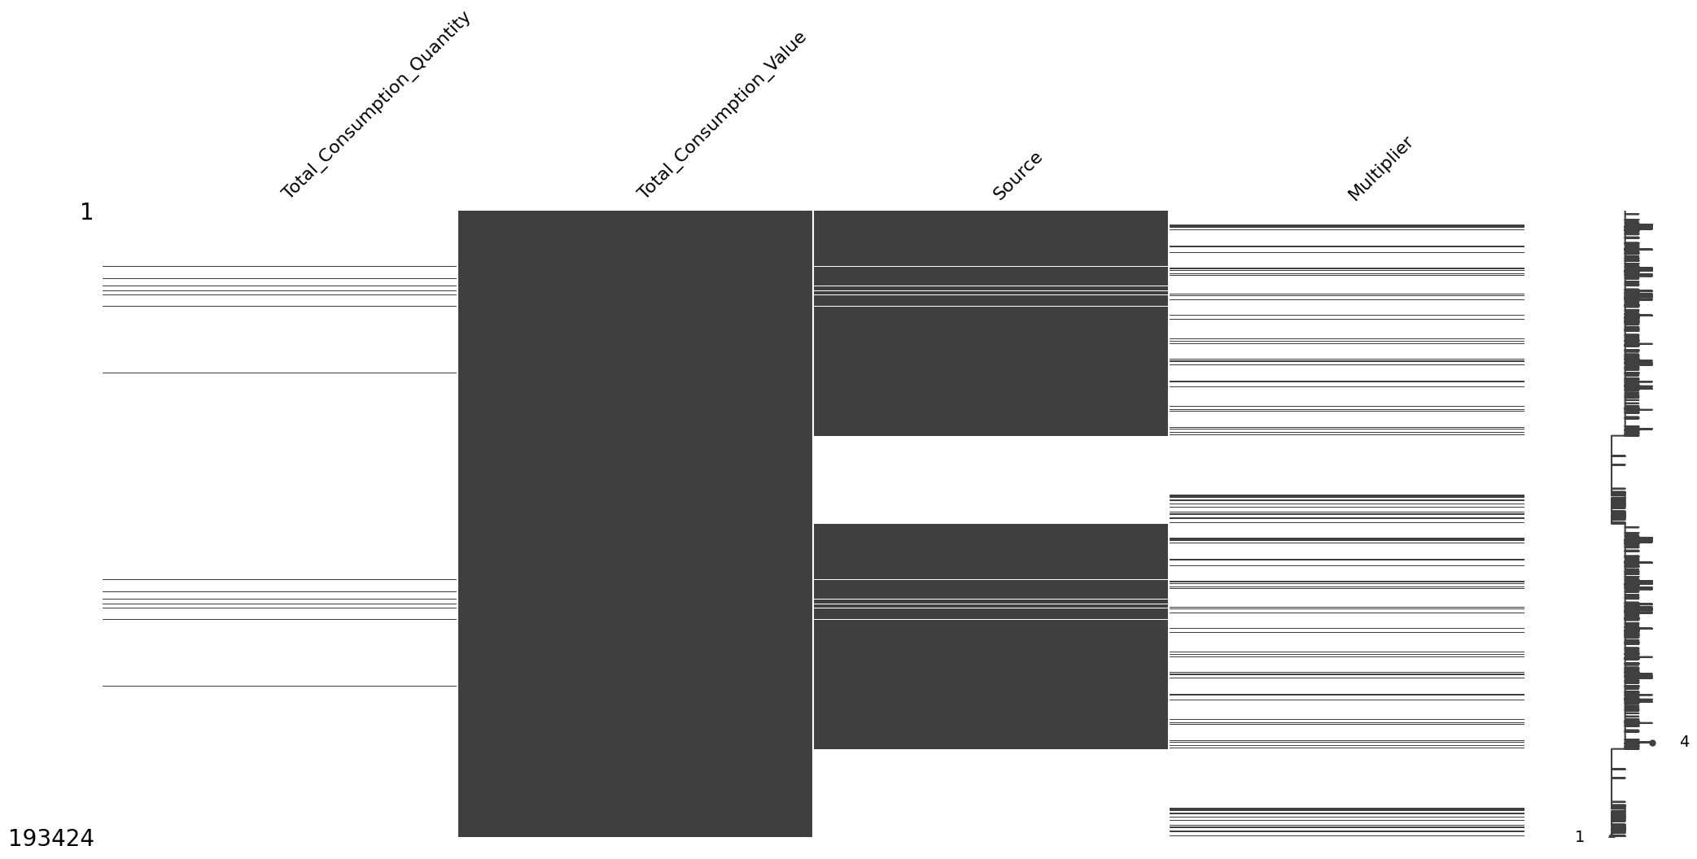
level 06: CONSUMPTION VALUE

Slide 11
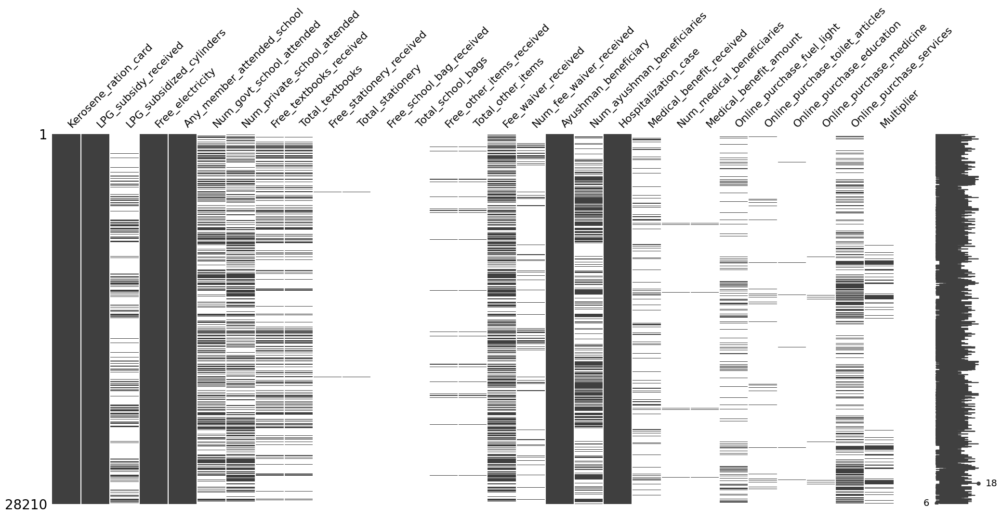
level 07: BENEFITS/ WALFARE

Slide 12
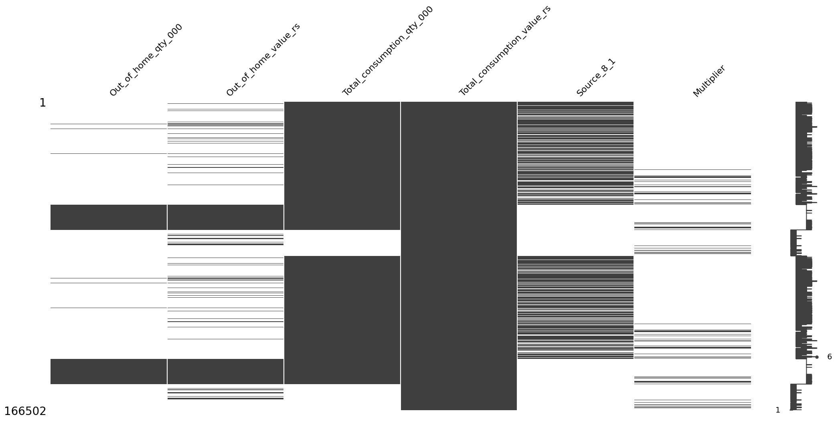
level 08: NON-FOOD ITEMS

Slide 13
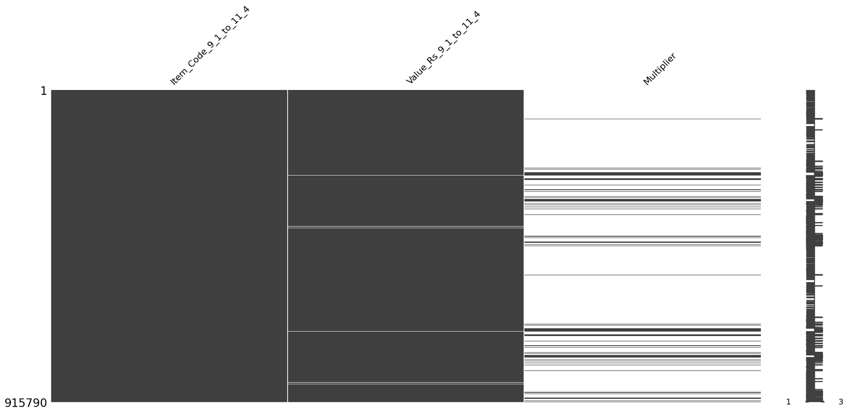
level 09: NON-DURABLES

Slide 14
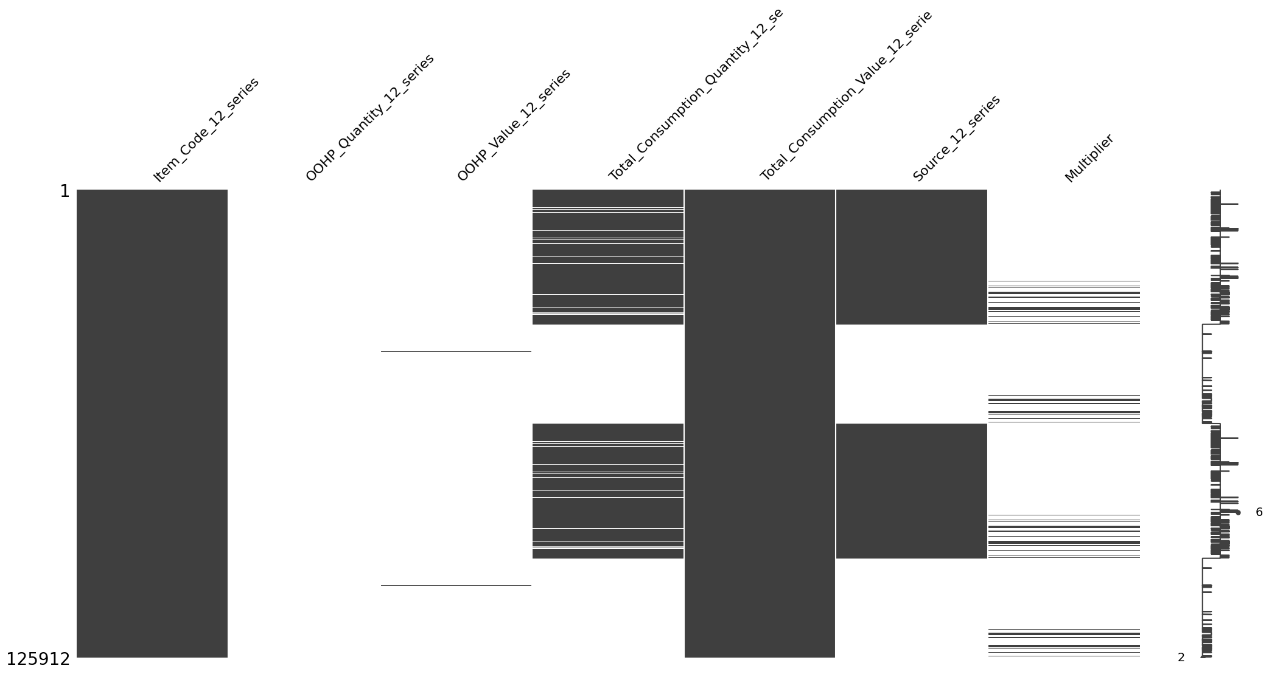
level 10: Services/Utillities

Slide 15
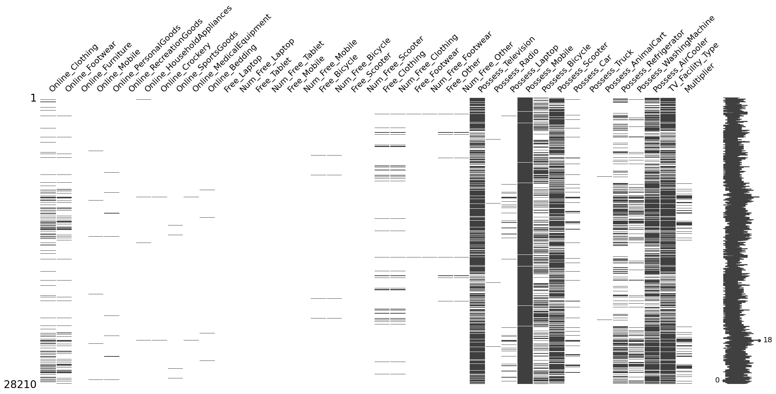
level 11: Assets/Possessions

Slide 16
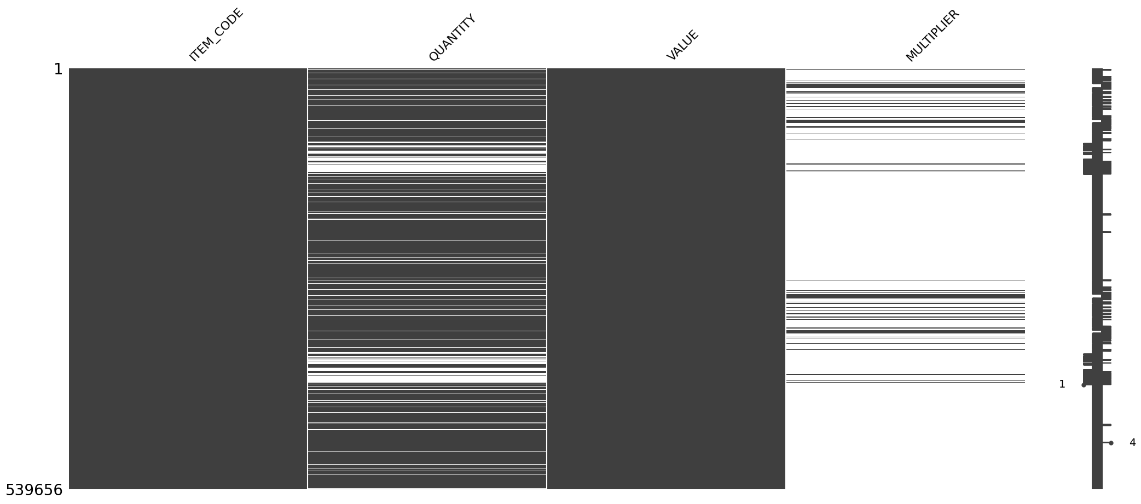
level 12: Clothing/Footwear

Slide 17
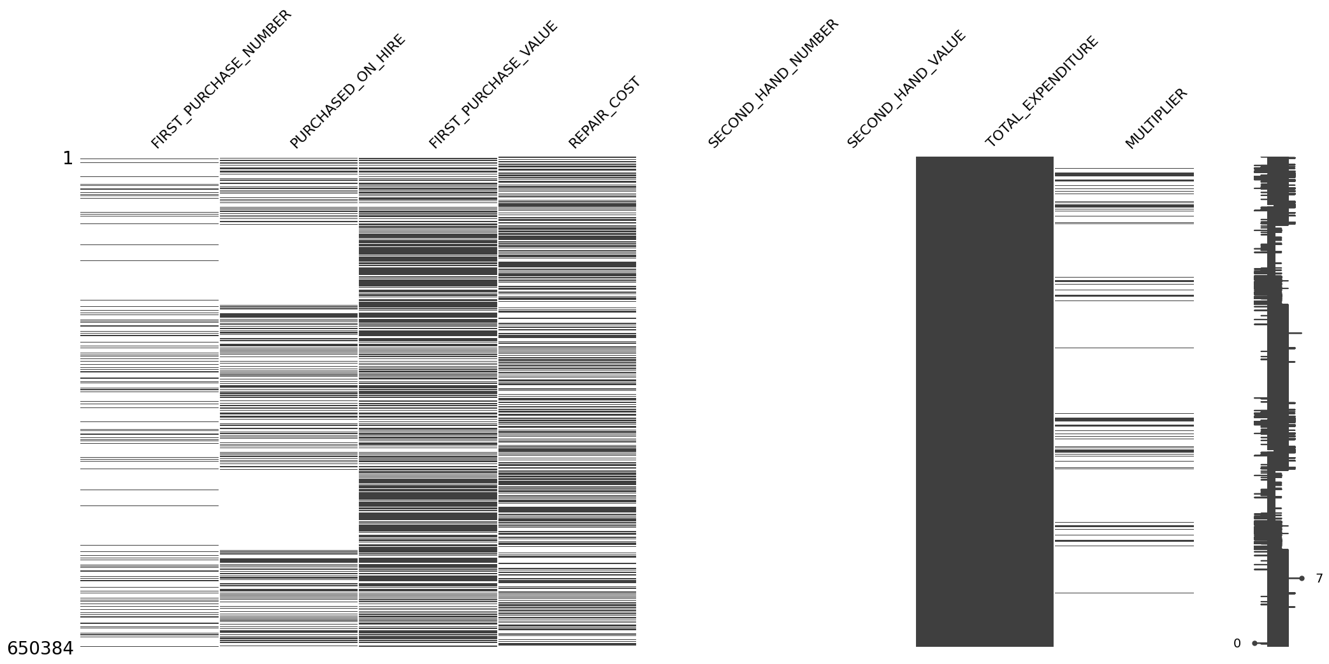
level 13: Durable Goods

Slide 18
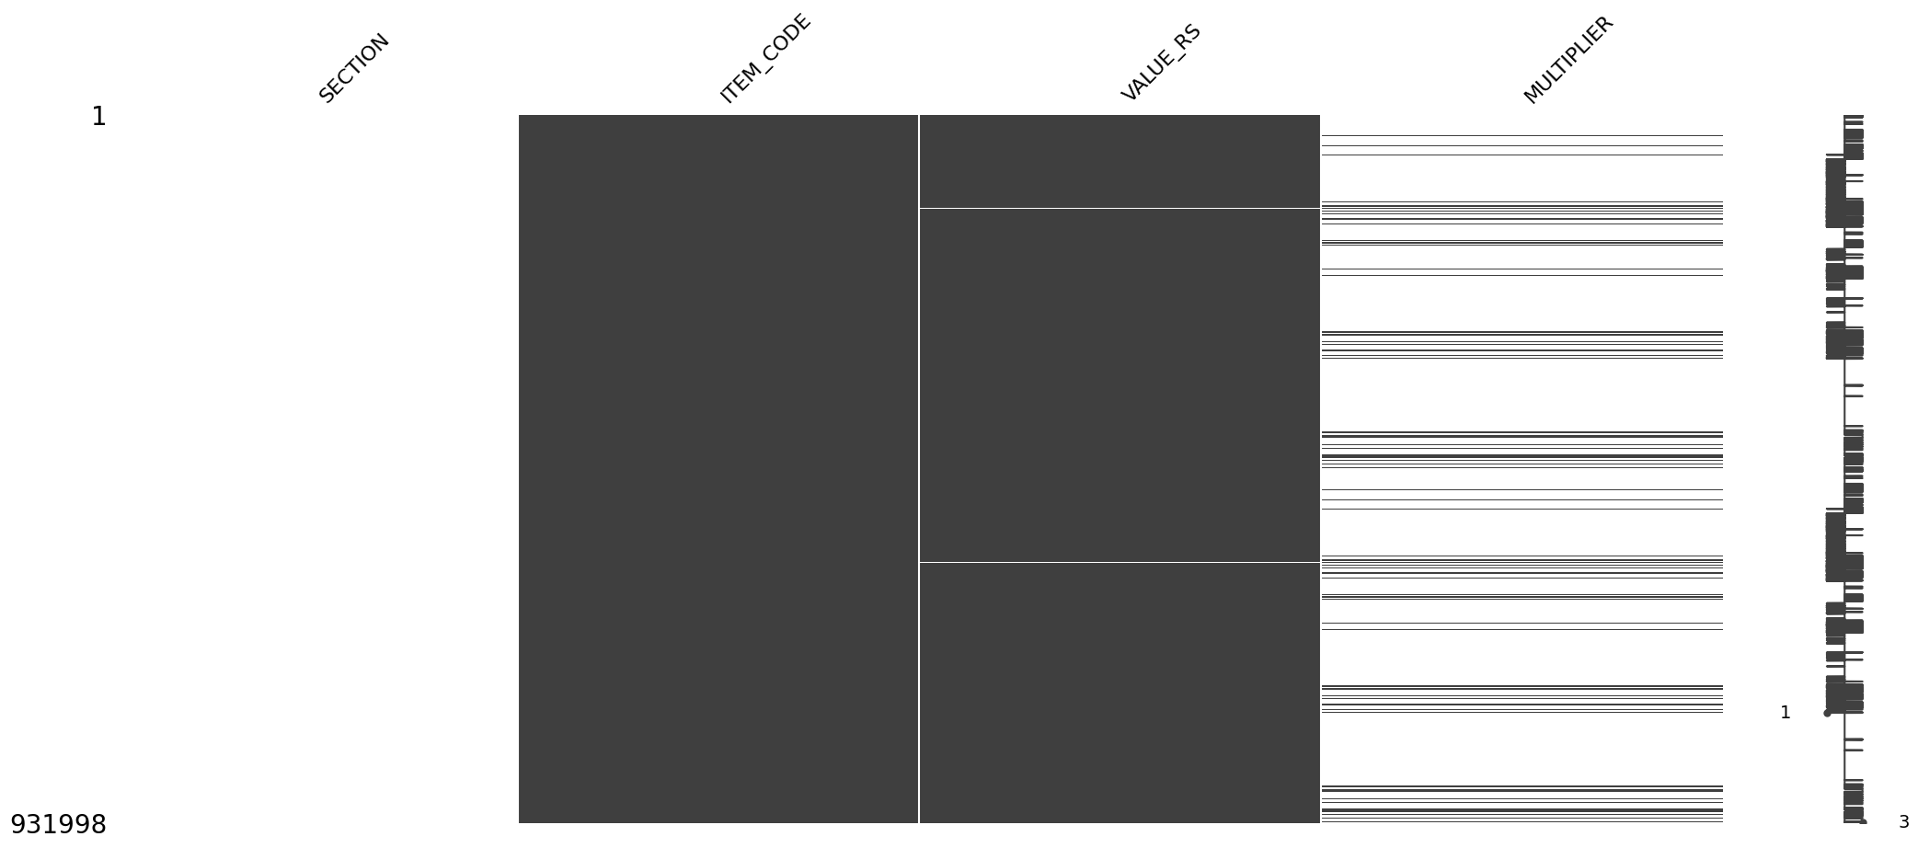
level 14: Total Expenditure

Slide 19
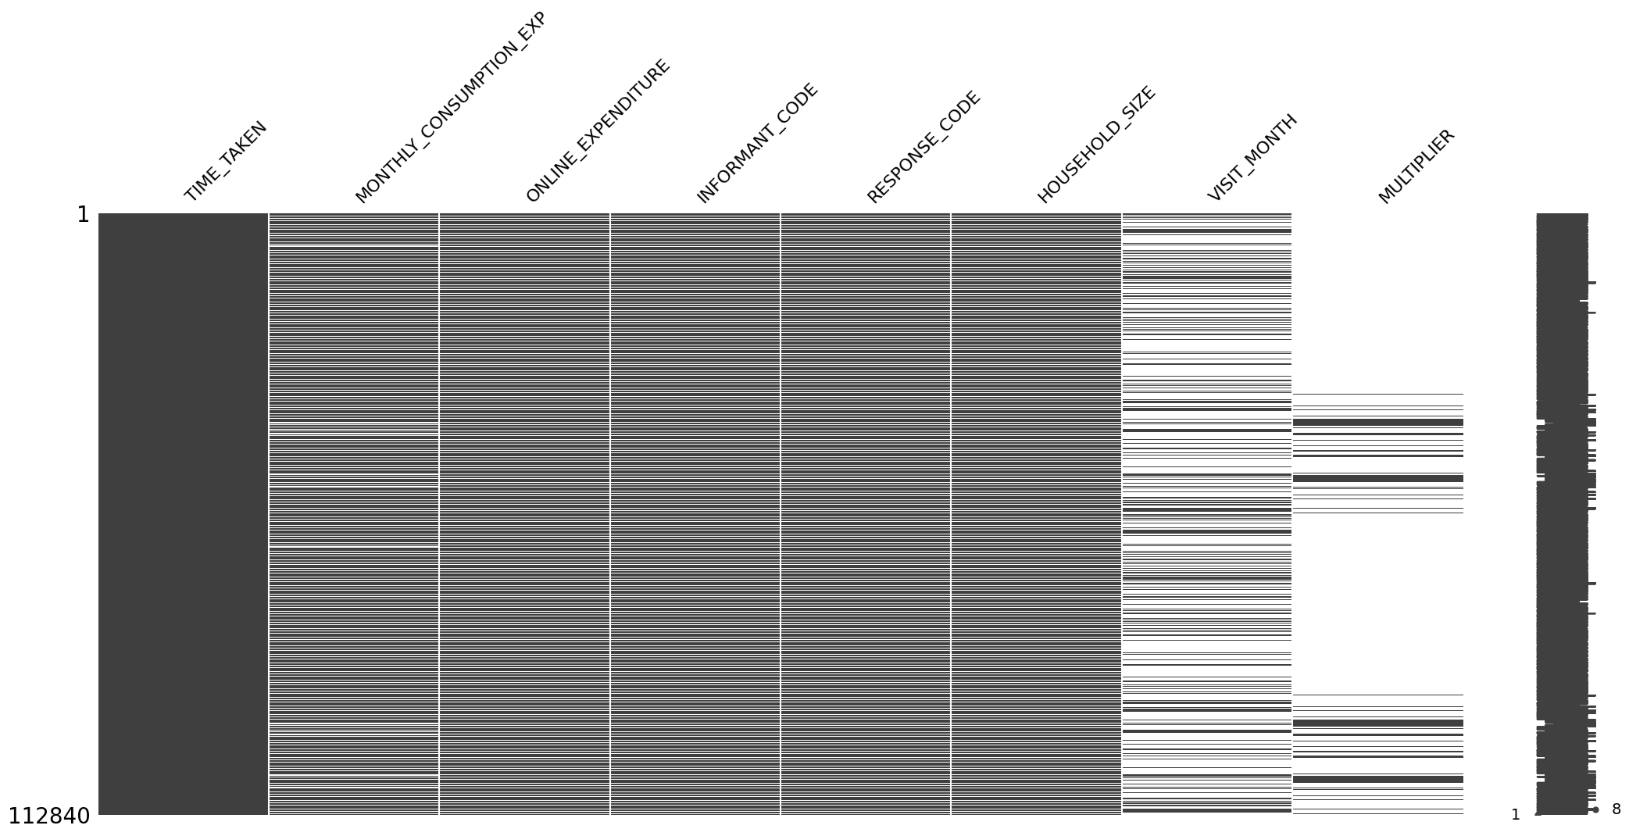
level 15: Summary/ Metadata

Slide 20

Filling Method Suggestions
  If these features are checkboxes in the survey, fill missing values with 0 (No).
  If these features are categorical, create bins or categories as needed.
  If these features are numerical, handle missing values using methods such as KNN imputation, mean/median imputation, dropping rows, or iterative imputation.
Source:
https://github.com/Rudra-G-23/Play-with-Data/blob/main/Data_Accessing_%26_Cleaning/Handling%20Missing%20Values%20Chart.md

Slide 21
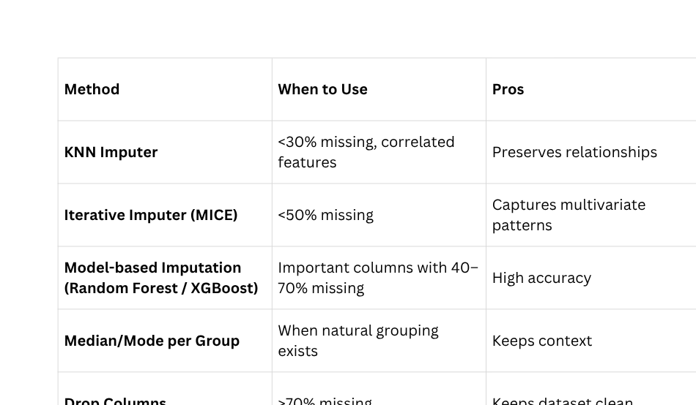
Filling Method Suggestions
Source:
https://github.com/Rudra-G-23/Play-with-Data/blob/main/Data_Accessing_%26_Cleaning/Handling%20Missing%20Values%20Chart.md

Slide 22

Conclusion
  After analyzing the dataset, it was observed that several features contained missing (null) values that could potentially affect the accuracy and reliability of the model. To address this issue, appropriate imputation techniques were suggested based on the nature of each feature.
  For checkbox-type survey features, missing values can be reasonably replaced with 0 (No), assuming non-selection indicates a negative response. For categorical variables, grouping or binning similar categories helps maintain data consistency while reducing sparsity.
  For numerical features, more sophisticated imputation methods such as K-Nearest Neighbors (KNN) imputation, mean or median imputation, iterative imputation, or row dropping were proposed depending on the proportion of missing data and the importance of the feature.
  These methods aim to minimize data loss, preserve distribution characteristics, and improve the overall quality and performance of subsequent analyses or predictive modeling.

Slide 23

Thank You
Rudra Prasad Bhuyan

